Slide 1


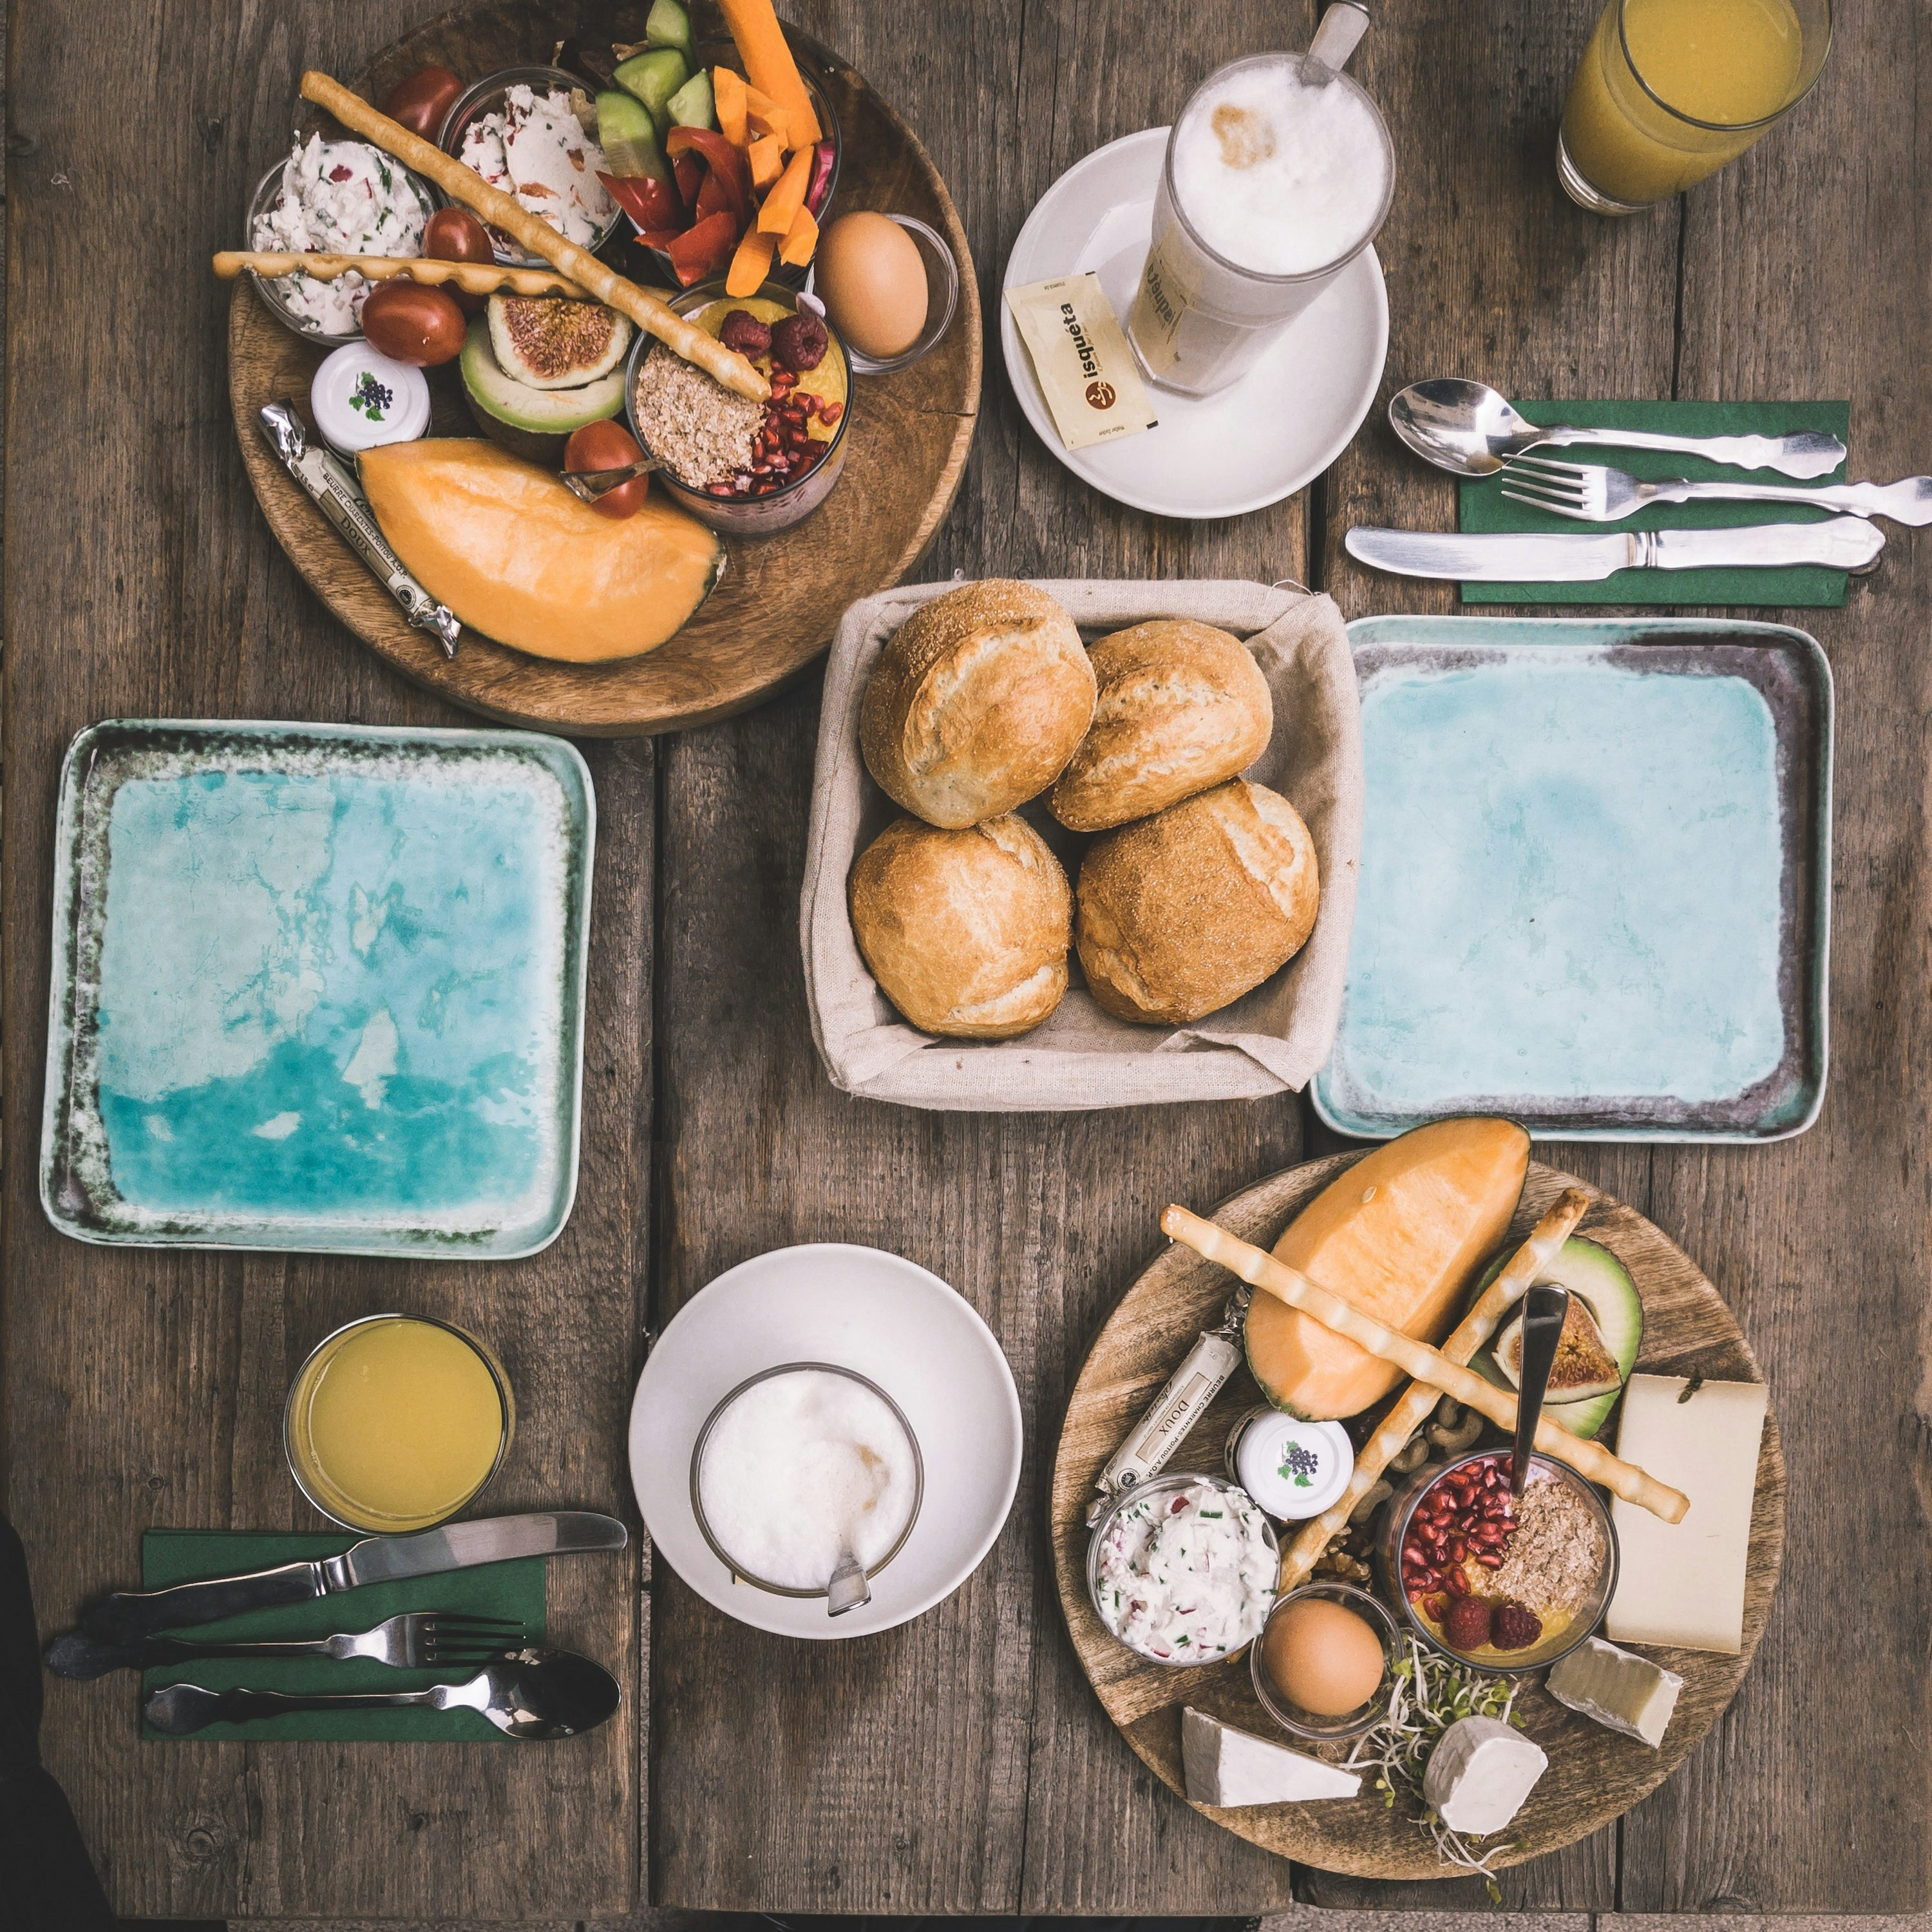
FOOD ORDERING SYSTEM
SUBMITTED BY:
TANMAY SAXENA
2019179
CSE-AI&DS
UNDER MENTORSHIP:
Mr. Pramod Mehra
Assistant Professor

Slide 2

INTRODUCTION
The Online Ordering System revolutionizes the food purchasing experience by offering a seamless and efficient method for customers to order food online without visiting the restaurant. Leveraging the power of the internet, this system connects restaurants or food companies directly with customers. Customers can effortlessly browse the restaurant's website, explore a diverse range of food items, select their desired dishes, and place their orders. These orders are then delivered to their doorstep at a preferred time by a delivery person.
Key Benefits:
User:-
Interactive
Up-to-Date Menu
Easy Order Review
Convenient Delivery
Restaurant:-
Automated Order Management
Enhanced Operational Efficiency
Customer Satisfaction

Slide 3

PROBLEM STATEMENT
The current process of ordering food from restaurants is inefficient and inconvenient for both customers and restaurant owners.
Customers face several challenges:
Limited Accessibility: Customers often find it challenging to access menus and place orders outside of regular business hours.
Long Wait Times: During peak hours, customers may experience long wait times on phone lines or at the restaurant.
Order Inaccuracies: Miscommunication between customers and restaurant staff over the phone can lead to incorrect orders.
Lack of Information: Customers may lack information about restaurant offerings, specials, and customer reviews, making it difficult to make informed choices.
Payment Hassles: Traditional payment methods can be cumbersome, with issues such as lack of change or credit card processing problems.
From the perspective of restaurant owners:
Order Management: Managing orders from multiple channels (phone, walk-ins) can be chaotic and error prone.
Resource Allocation: Inefficient order management leads to poor resource allocation, affecting service quality and customer satisfaction.
Customer Engagement: Lack of direct engagement with customers makes it difficult to build loyalty and offer personalized services.
Operational Costs: High operational costs due to manual order processing and management.

Slide 4
METHODOLOGY
Project Inspection:
Define clear objectives and functionalities for the Online Food Ordering System, emphasizing the quality food at doorstep with efficient time.
Identify target user demographics, preferences, and pain points to tailor the app accordingly.
Technology Stack Selection:
Choose appropriate technologies and frameworks for Web Application development, ensuring scalability, performance, and compatibility.
I used the MERN Stack for development of my application.
Leverage tools such as Visual Studio for efficient coding and debugging.
Database:
Create a database using the MongoDB Atlas and connect to the application using the mongoose library of Node.js.

Slide 5
Frontend Development:
Implement the Website app's frontend using React.js development tools.
Ensure responsiveness and smooth transitions between app screens, optimizing for various devices using media queries of CSS.
Designing the Application UI with the help of CSS and structure and logics with the help of HTML and JavaScript functions, respectively.
Frontend Contains two modes one for the End User’s from where they can order food and another for the admin panel from where admin can manage all the orders and menu items.
Backend Development:
Design and implement a robust backend infrastructure to support the app's functionality, focusing on real-time data processing and secure user authentication and other functionality of the application using Node.js.
Integration Between Frontend and Backend:
UI/UX of frontend and functionality of backend is integrated with the help of the Express.js and Rest API call of ‘POST’ and ‘GET’ method, from we send the requested to backend with API calls and fetch the functionalities to the frontend.

Slide 6
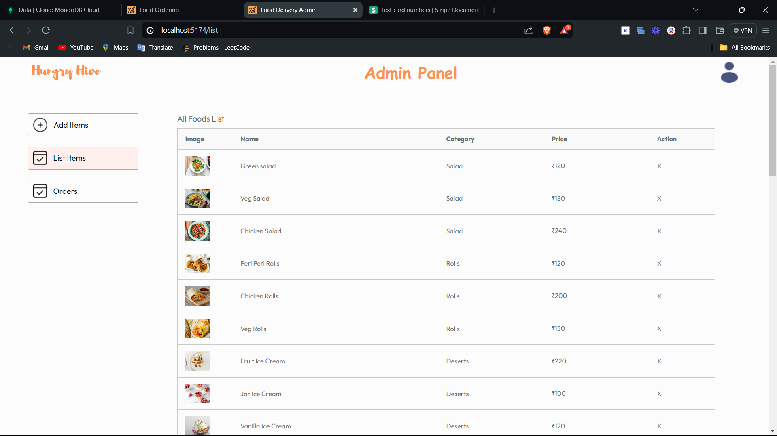
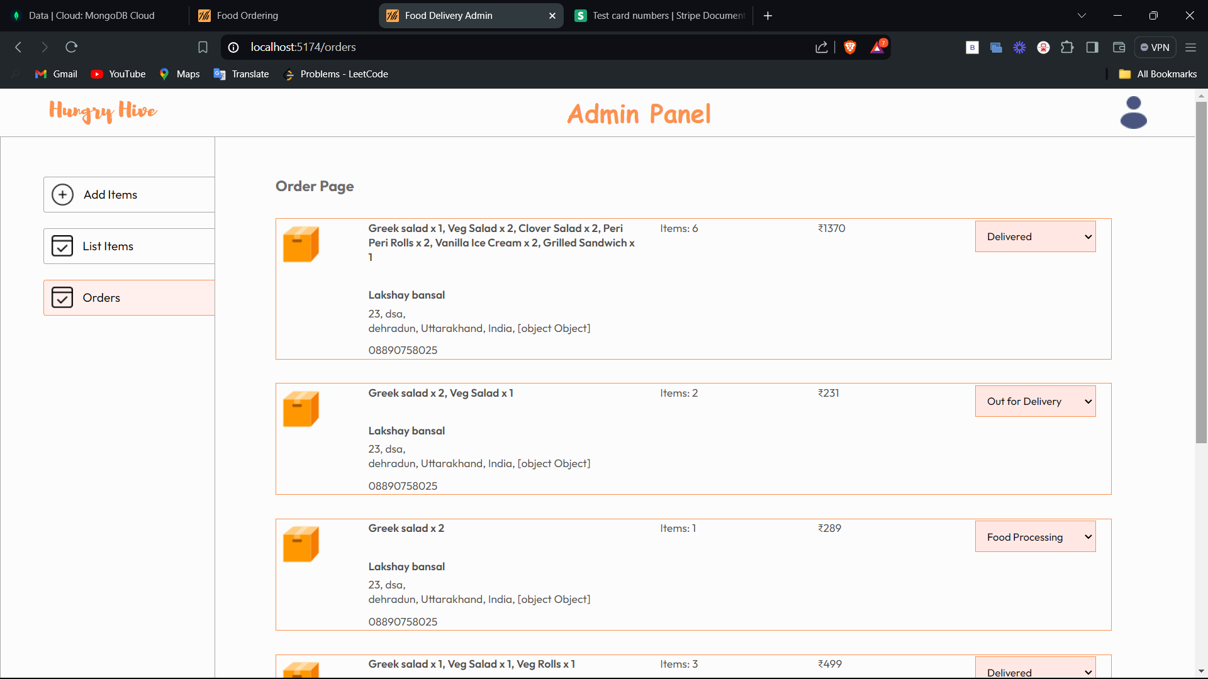
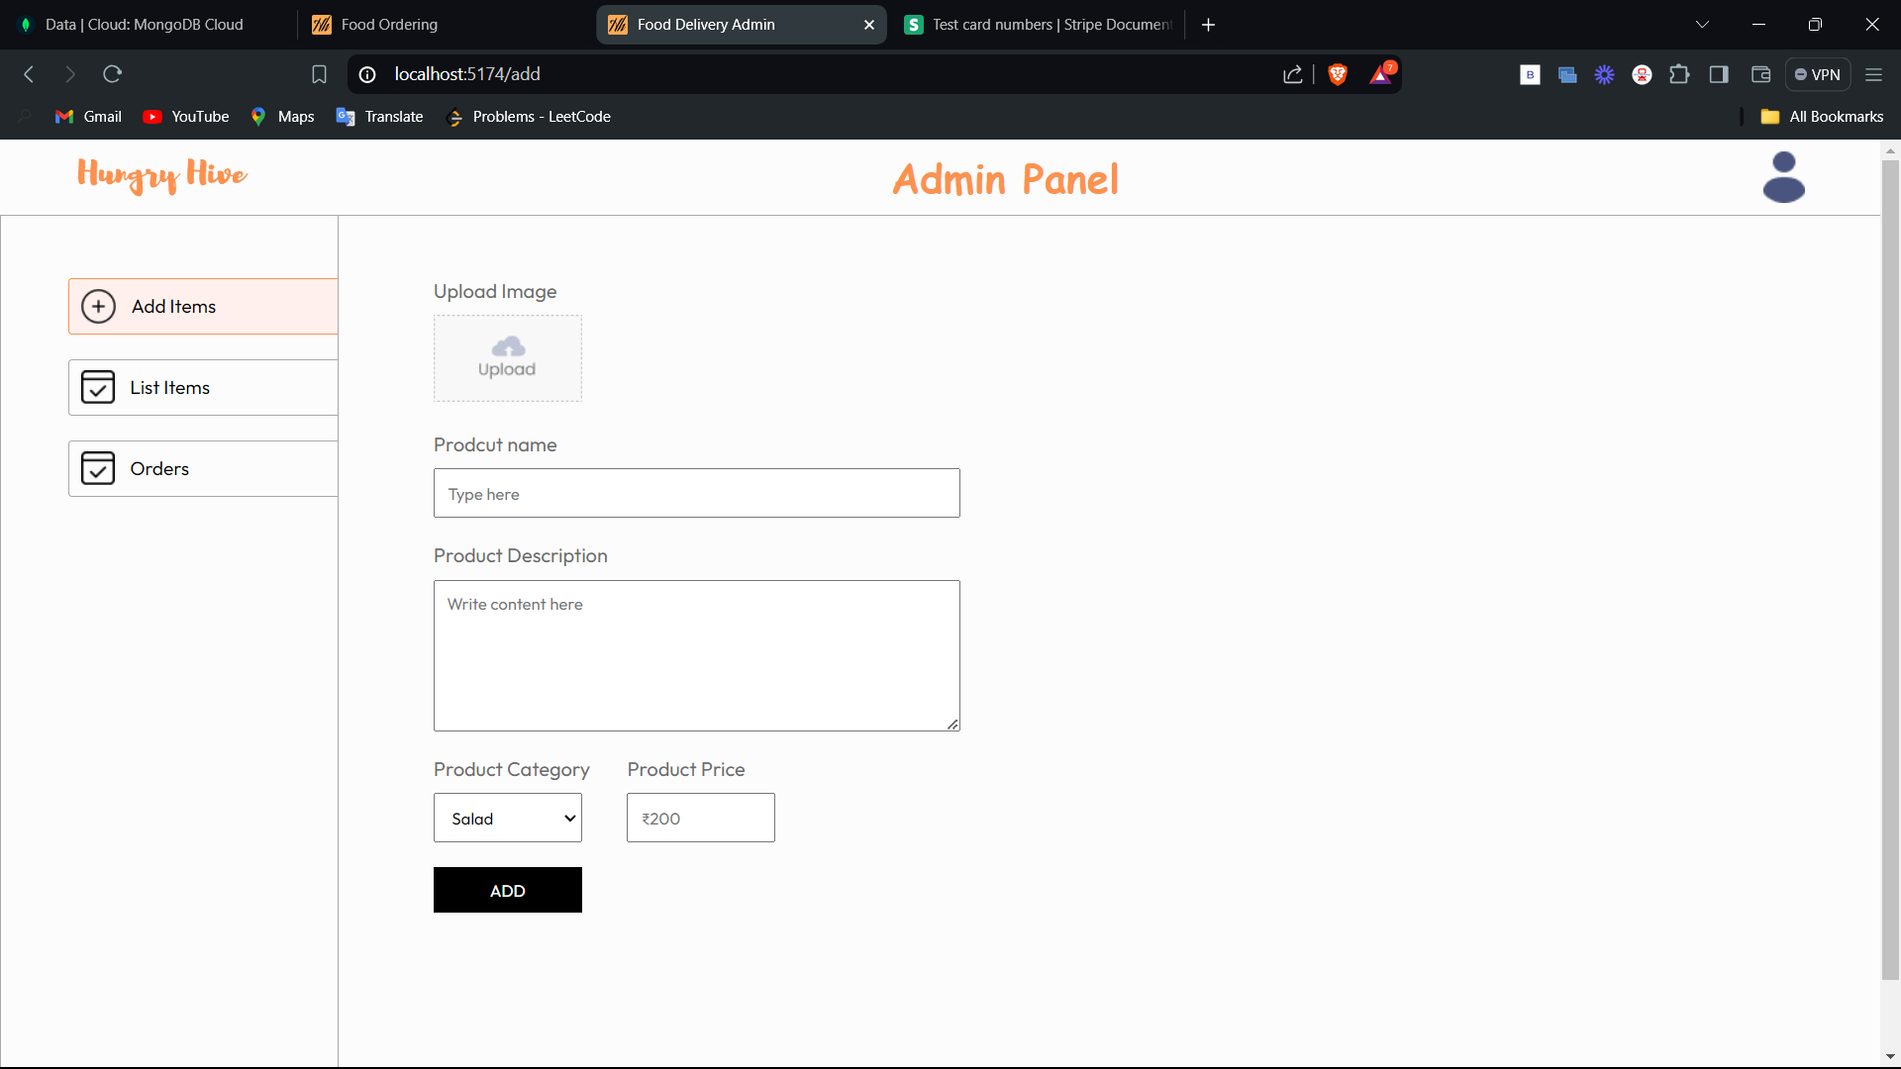
RESULTS AND DISCUSSION
List Items:
Orders Page:
It shows the list of all items currently present the menu of the user application and admin can remove the items from this list.
This page shows all order by all the users to the admin, so they can update the status of the order and prepare an order.
Add Items:
In this admin can add new food items to the menu.
ADMIN PAGE

Slide 7
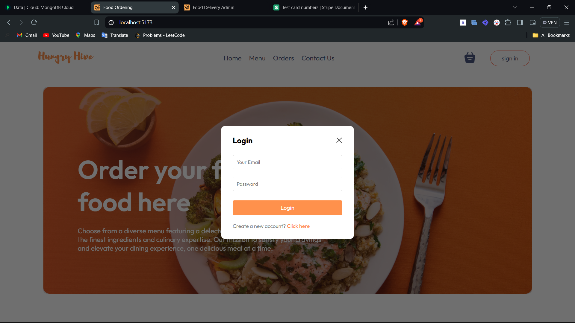
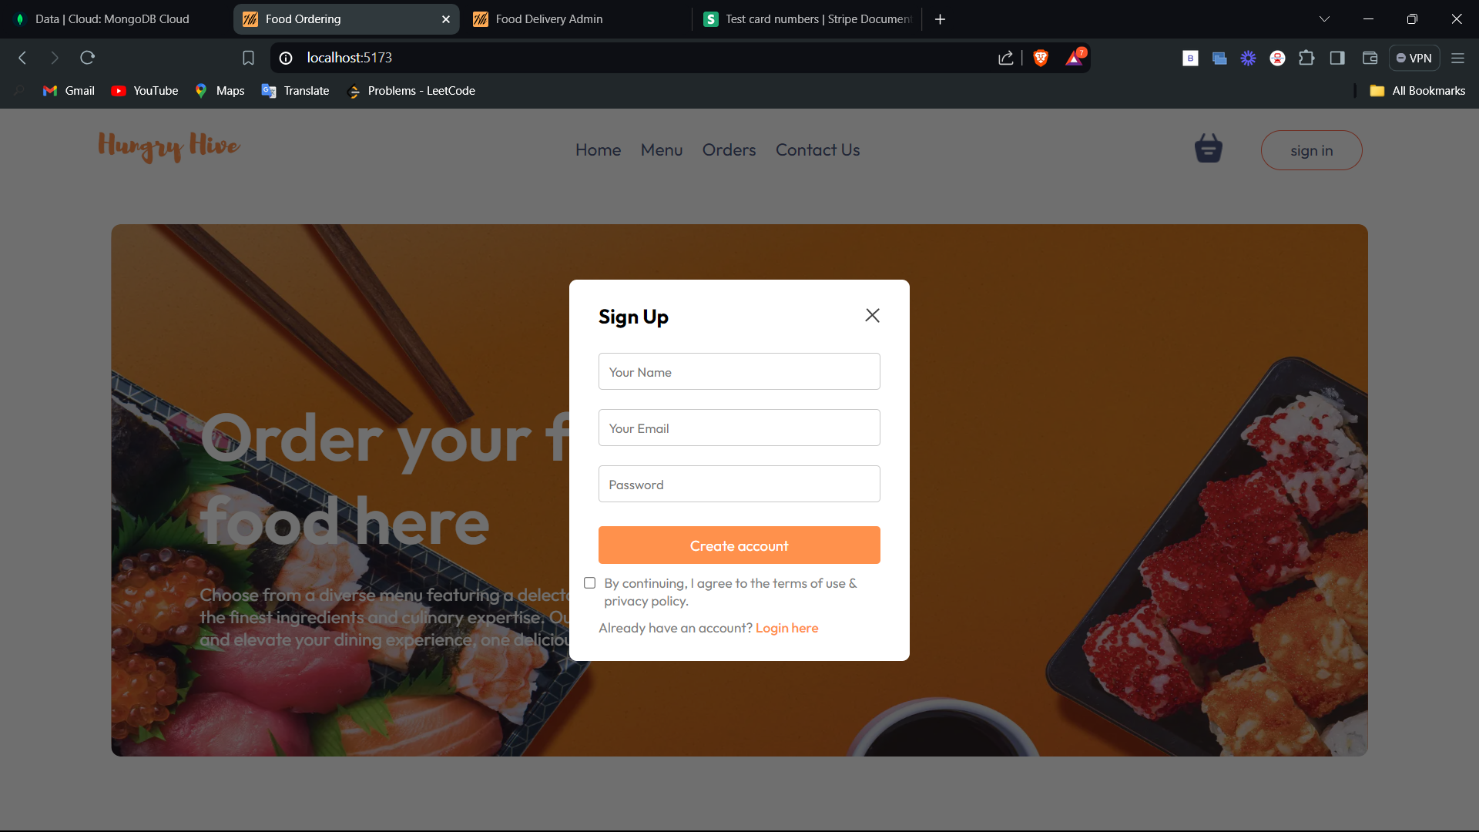
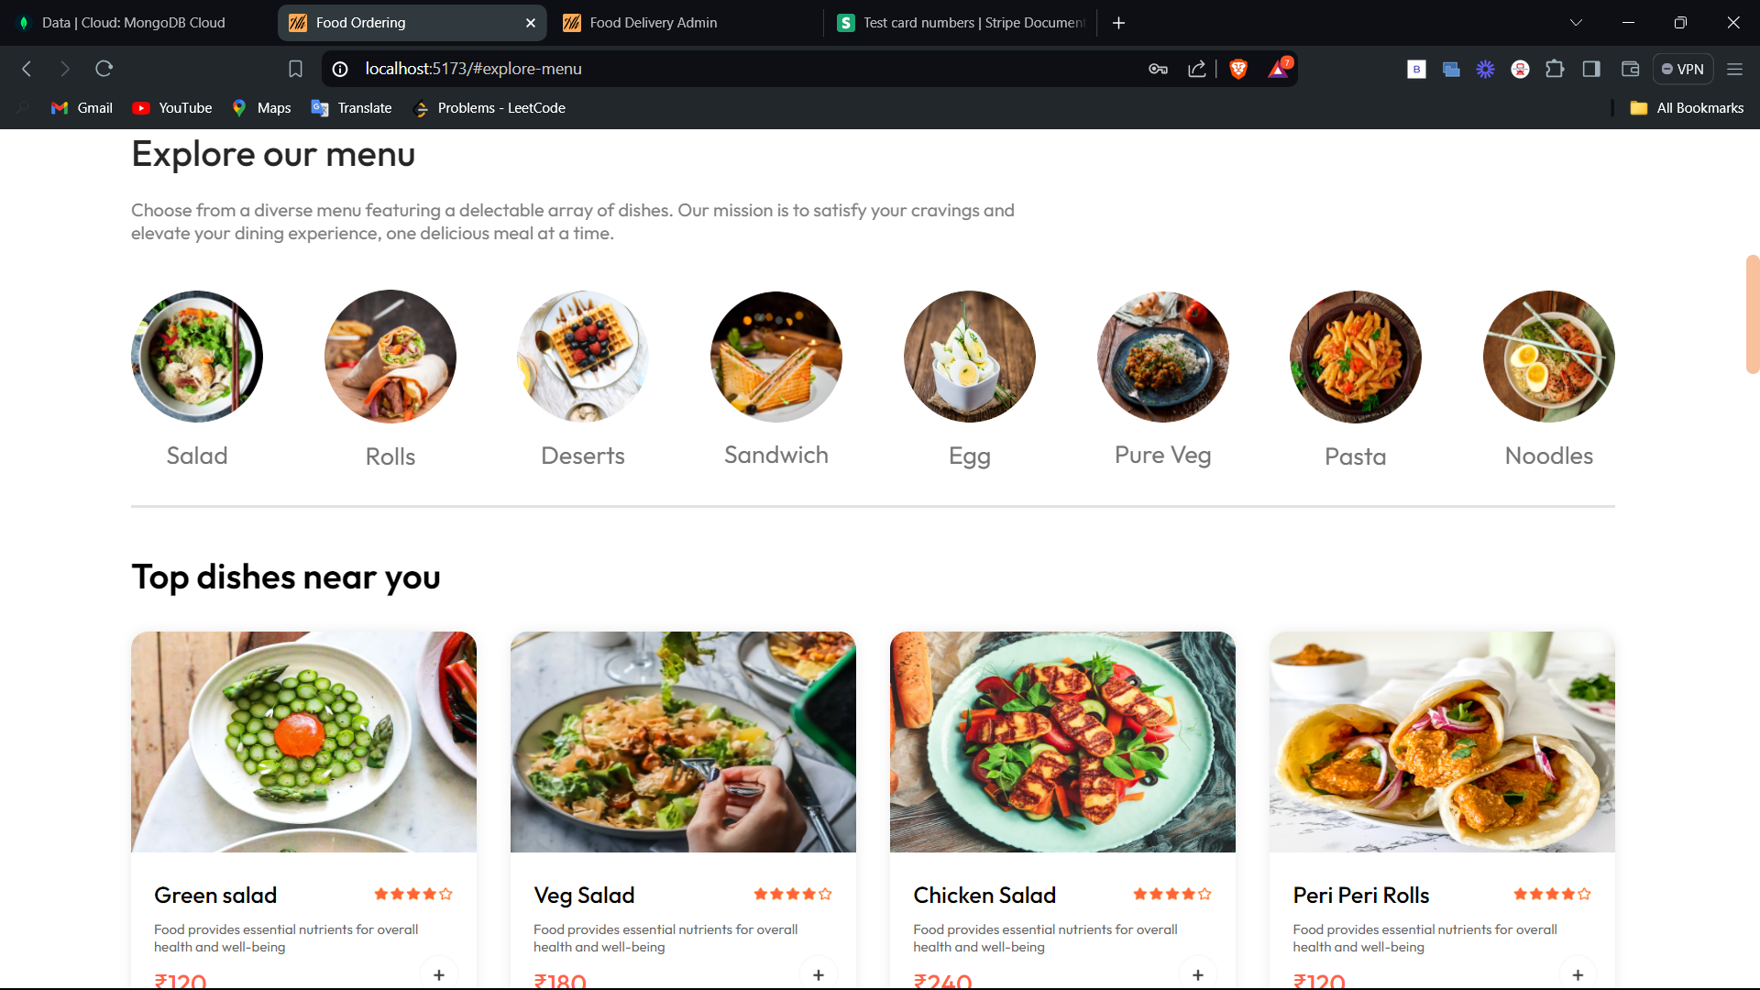
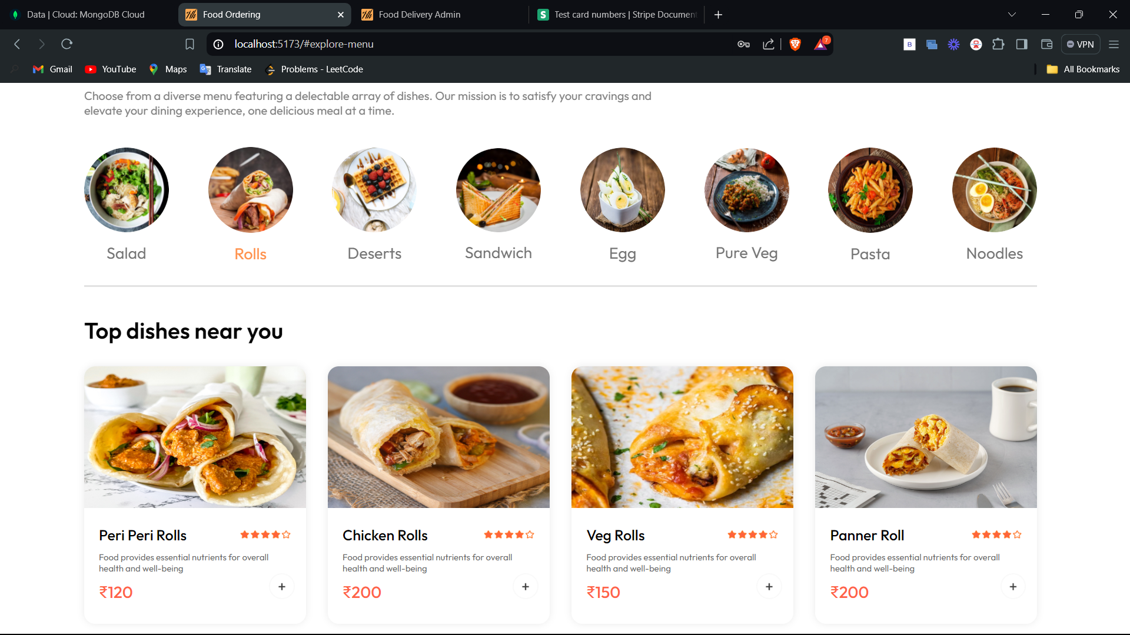
Register User and Login:
In this functionality customer can register to the application for first time and then after that he/she can access the application by login to site.
Fig. 1 Register User Pop-Up
Fig. 2 Login Pop-Up
Explore Menu:
In this functionality user can check the menu by going to explore menu section in application and select the food of their choice.
In Addition, it also provides the filter option by clicking on the images of category.
Fig. 3 Explore Menu Page
Fig. 4 Menu with Filter Food by Category

Slide 8
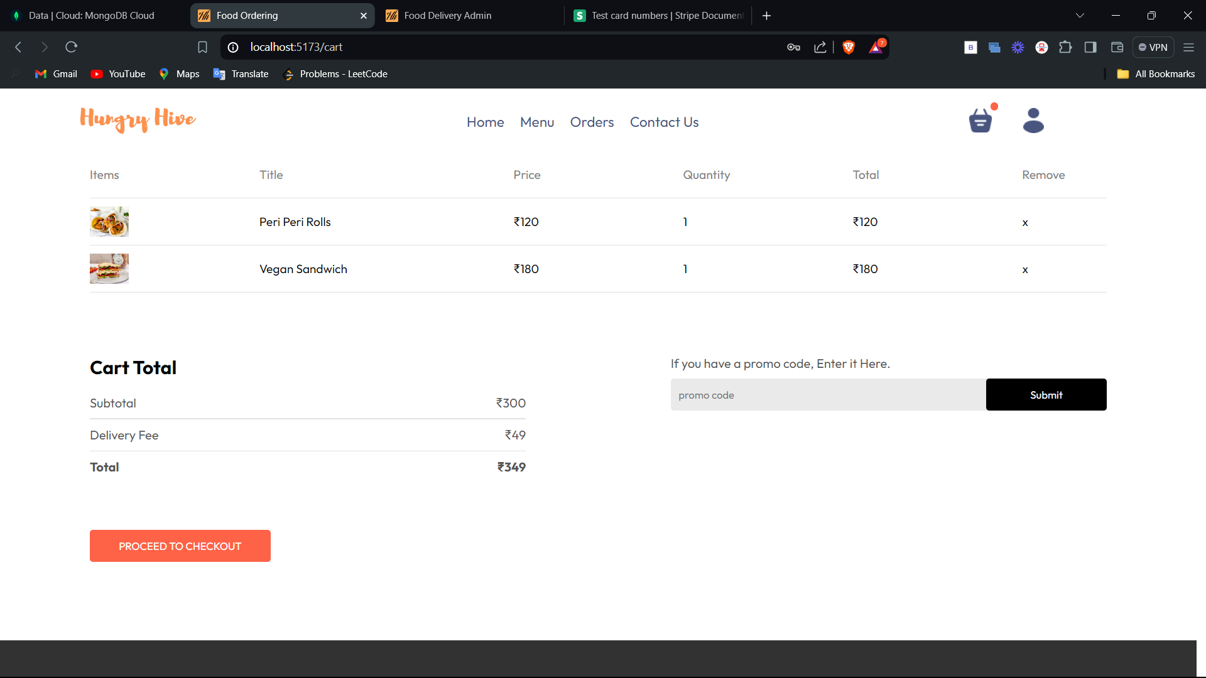
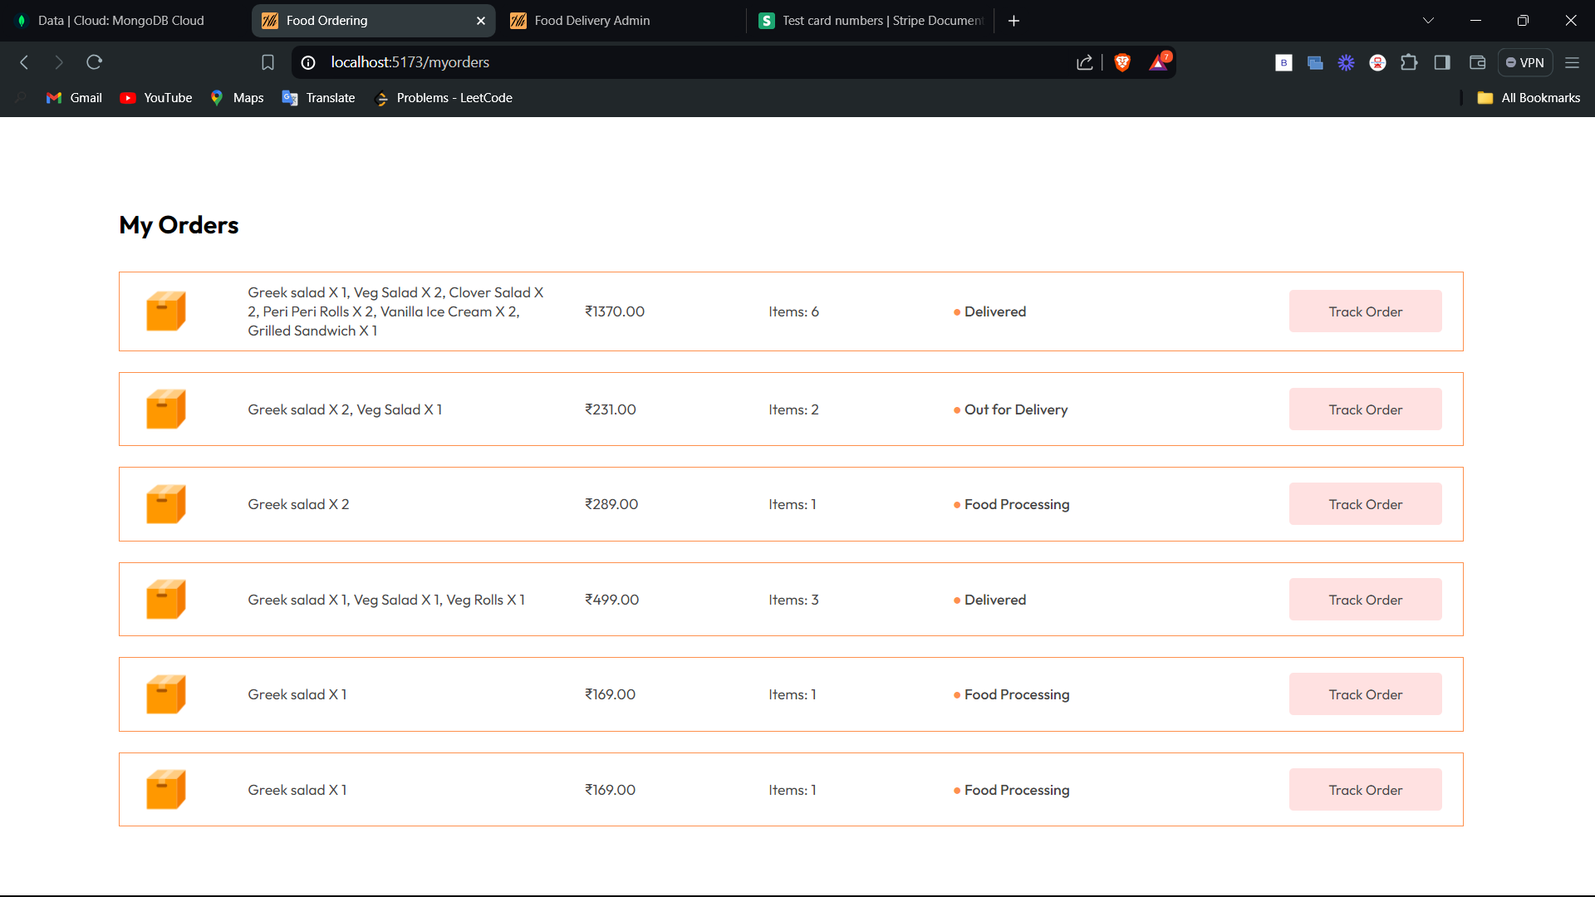
Cart:
Orders Page:
In this user can check the food items that are selected by them to order and, they can remove the items from the cart. It also shows the total amount of the order including delivery charges.
In this page user can his/her orders and track the status of the order.

Slide 9
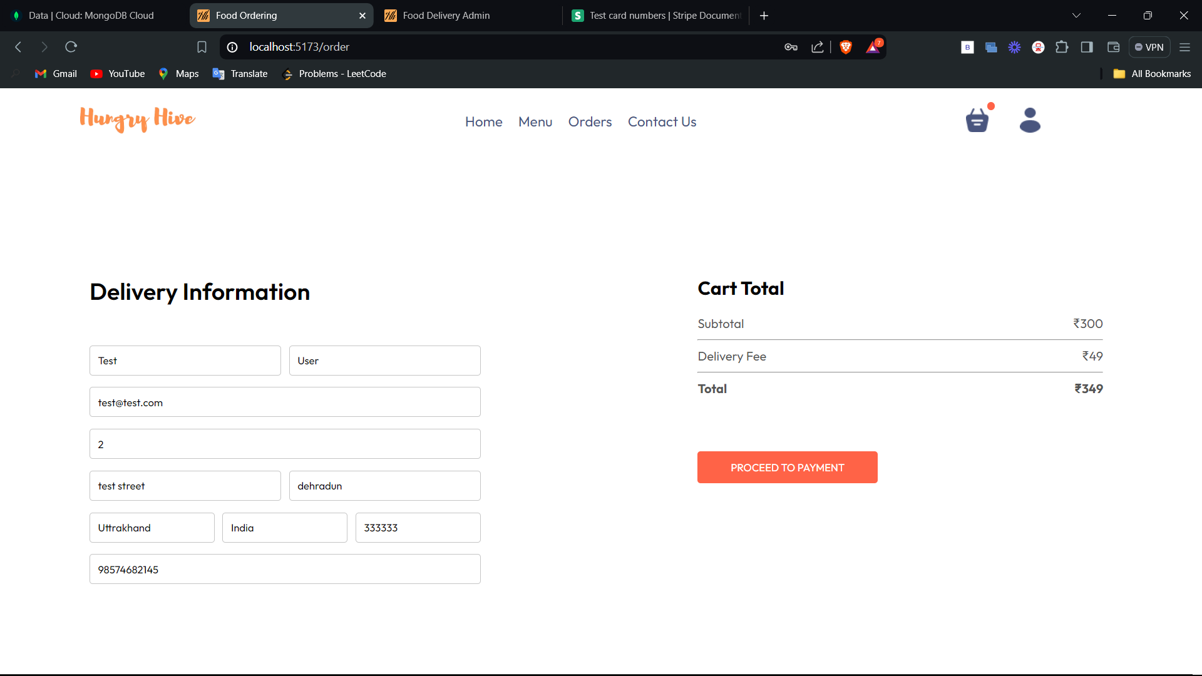
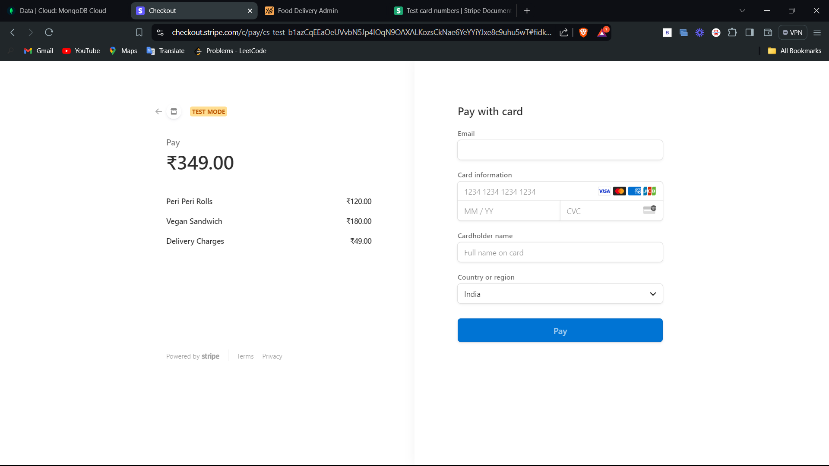
Proceed to Payment Page:
Payment Gateway:
In this user must mention their details like address, contact details for the delivery and then finally go to payment gateway.
Here user must mention the payment details, finalise the payment, if payment is successful then procced to orders page otherwise redirected to home.

Slide 10
CONCLUSION AND FUTURE WORK
CONCLUSION:
The online food ordering industry has grown rapidly due to digital solutions. Success hinges on user-friendly interfaces, extensive restaurant networks, real-time tracking, and personalized recommendations. Apps like Uber Eats, Grubhub, and DoorDash set high standards for user experience. Advancements in mobile development, cloud computing, and AI/ML boost performance, scalability, and personalization. Users prefer convenience, variety, promotions, and value reviews and ratings for trust. Challenges include order accuracy, delivery logistics, and data security, requiring continuous innovation and understanding of user needs.
FUTURE WORK:
Enhanced Personalization:
AI-Driven Insights
Behavioral Analysis
Improved Order Accuracy:
Voice Recognition
Augmented Reality (AR)
Advanced Delivery Solutions:
Drone Deliveries
Autonomous Vehicles
Enhanced Security Measures:
Blockchain Technology
Advanced Encryption
Sustainability Initiatives:
Eco-Friendly Packaging
Carbon Footprint Tracking
Expanded Features:
Social Integration
Loyalty Programs

